Slide 1
OPLS Hierarchical Clustering
Paul Anderson
11/29/2009

Slide 2
What is the point?
OPLS-DA is a method that can use a combination of variables (bins) to discriminate between two or more groups. For the two group problem, labeling the data is simple (1 = treatment, 2 = control). But for the three group problem the labeling is more complicated (0 = control, 1 = treatment at 24 hours, ? = treatment at 48 hours). One method to get around this problem is to run OPLS on a two group problem (e.g., 50 mg/kg at 48 hours versus control). Then apply this model to other times and other doses. This provides a scores plot that can then be analyzed and used as input for hierarchical clustering.

Slide 3
OPLS (Paired versus Unpaired)
For the ANIT study we have paired samples, so using each animal as its own control is the most appropriate way to analyze the data.
This can be done by selecting Paired OPLS under statistics.
To run Paired OPLS you will need to merge your collections into one large collection.
Then you can specify the classifications (groups) and the paired and unpaired time points. The paired time point is typically labeled 0, -1, or pre.
Please note that the spelling must be exact and that it is also case sensitive.

Slide 4
Results
Important: Please record the this URL to view your results at a later time.
OPLS documentation
OPLS ID: 307
Percent x variance explained by the model: 43.1995
Percent y variance explained by the model: 96.6357
Number of OPLS components: 3
Using cross validation: Q²: 0.8900 Q² is significant at 0.0100 with a cutoff of 0.3679 (1) Accuracy: 89.4737% [Expand/hide significant features]
[Expand/hide table of results]
[Expand/hide formatted table]
[Expand/hide MATLAB scores data]
[Expand/hide MATLAB loadings data]
[Expand/hide MATLAB S-plot data]
[Expand/hide add new data to scores plot]
[Expand/hide add new data to PAIRED scores plot]
Generate a scores plot first
Then you can add data to the plot
by running this command.

Slide 5
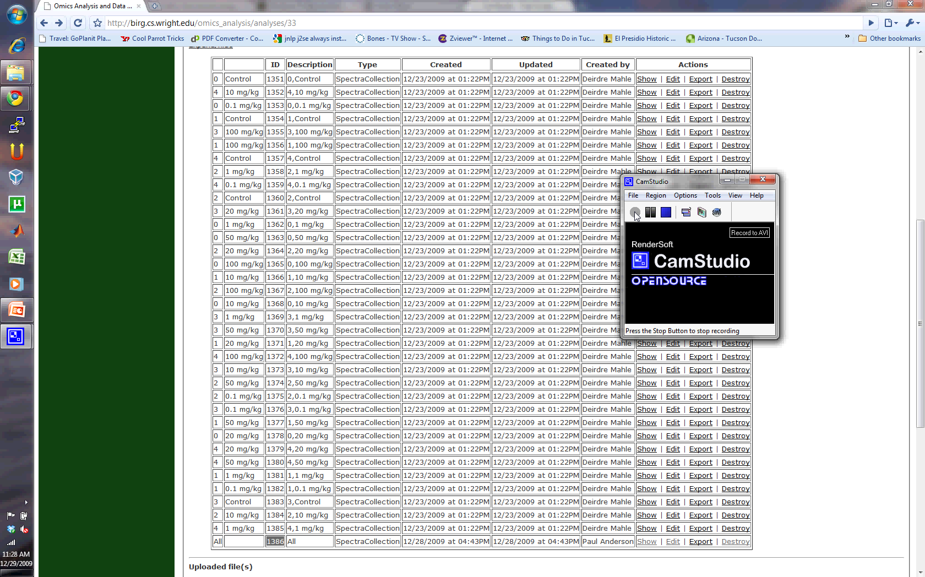
Click to start

